Slide 1
Micro wind
PowerPoint presentation
Unit 301: Understand the fundamental principles and requirements of environmental technology systems

Slide 2
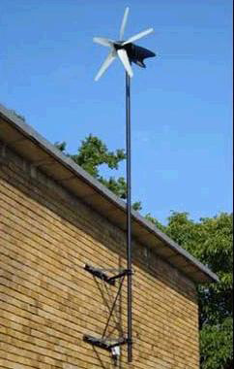
Micro wind
Wind turbines harness the power of the wind and use it to generate electricity.
Forty percent of all the wind energy in Europe blows over the UK, making it an ideal country for domestic turbines (known as 'micro wind' or 'small-wind' turbines).
A typical system in an exposed site could easily generate more power than your lights and electrical appliances use.

Slide 3
Micro wind
Wind turbines use large blades to catch the wind.
When the wind blows, the blades are forced round, driving a turbine which generates electricity.
The stronger the wind, the more electricity produced.

Slide 4
Micro wind
There are two types of domestic-sized wind turbine:
Pole-mounted: these are free standing and are erected in a suitably exposed position, often around 5kW to 6kW.
Building-mounted: these are smaller than mast mounted systems and can be installed on the roof or wall of a home where there is a suitable wind resource. Often these are around 1kW to 2kW in size.

Slide 5
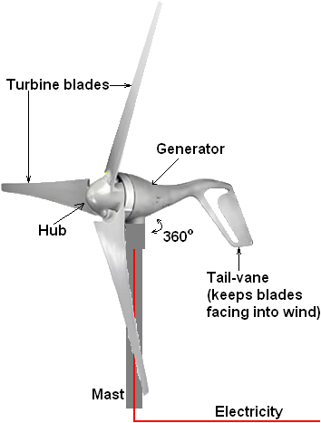
Micro wind
Most wind turbines use blades that are shaped similar to aircraft wings to harness the energy in the wind.
Horizontal axis wind turbines

Slide 6
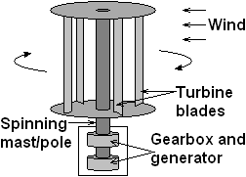
Micro wind
Most wind turbines use blades that are shaped similar to aircraft wings to harness the energy in the wind.
Vertical axis wind turbines

Slide 7
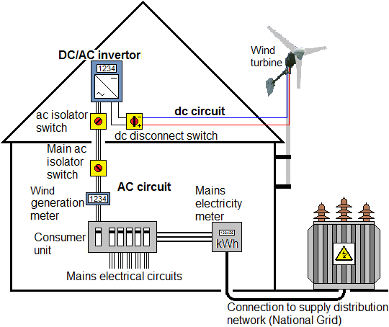
Micro wind

Slide 8
Planning permission
Planning permission is required to install a wind turbine in Wales or Northern Ireland. Contact your local authority for details.
In England and Scotland, a domestic wind turbine may be classified as Permitted Development, in which case planning permission will not be needed but certain criteria must be met.

Slide 9
Planning permission
For building-mounted turbines, the criteria include:
the house is detached
the top of the turbine blades is no more than three metres above the top of the house, or 15 metres above the ground
all of the turbine is at least five metres from the edge of the householder's property.

Slide 10
Planning permission
For pole-mounted turbines, the criteria include:
the top of the turbine is no more than 11.1 metres above ground
all of the turbine is at least 1.1 times the height of the turbine away from the edge of the householder's property.

Slide 11
Planning permission
And for both types of turbine:
there is no other wind turbine and no air source heat pump on the site
the bottom of the blades is at least five metres above ground
the turbine's swept area is no more than 3.8m²
the site is not on land safeguarded for aviation or defence purpose.

Slide 12
Building Regulations requirements
If the wind turbine is attached to the building it needs to comply with Building Regulations including Part A on Structural Safety.

Slide 13
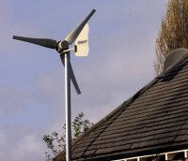
Advantages of micro wind
The wind is free and genuinely renewable and with modern technology it can be captured efficiently.
Benefit from the Governments feed‑in tariff.
The feed-in tariff is guaranteed by the Government for 20 years.
Producing your own power protects against rising energy prices.
Once the wind turbine is built the energy it produces does not cause greenhouse gases or other pollutants.
Although wind turbines can be very tall each takes up only a small plot of land.
Remote areas that are not connected to the electricity power grid can use wind turbines to produce their own supply.

Slide 14
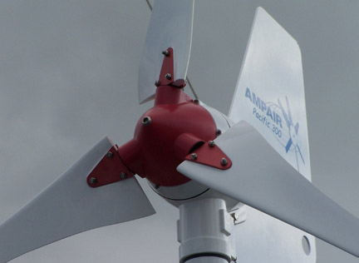
Disadvantages of micro wind
The strength of the wind is not constant.
Wind turbines can be noisy and building mounted ones can cause vibration.
When wind turbines are being manufactured some pollution is produced.
It may be beneficial to replace the inverter after 10 years.

Slide 15
Any questions?

